Slide 1

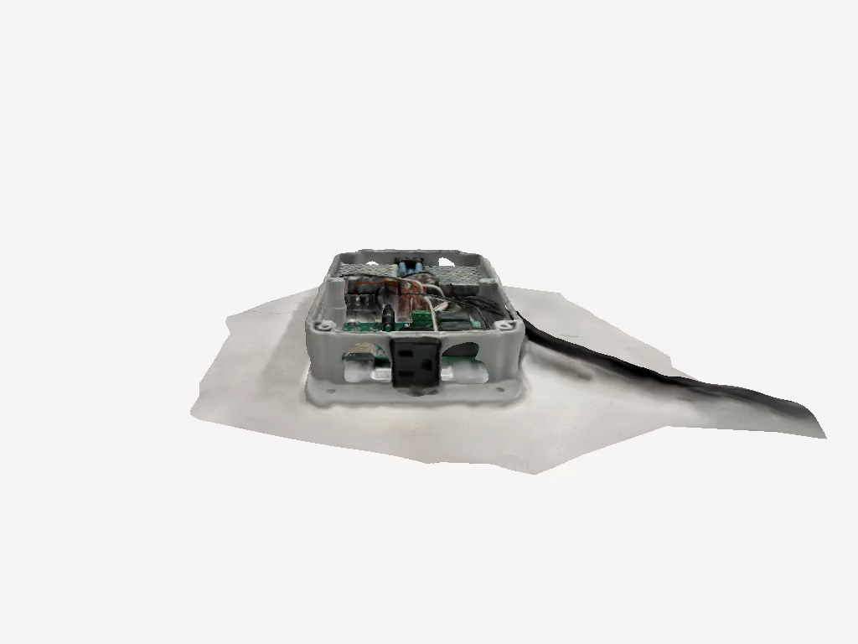
Your Smart Automatic Humidifier
Andrew Sherwin - Woojin Kim - Jalen Chen
TA: Surya Vasanth
Professor: Dr. Jonathon Schuh
Notes:
Every

Slide 2

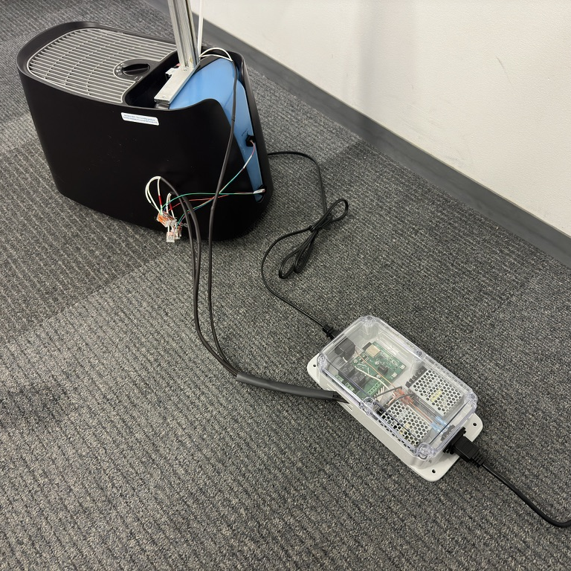
Agenda
Problem & Solution
Visual Aid
High Level Requirements
Block Diagram
RV Table
Project Achievements
Future Plans
Notes:
Andrew

Slide 3

Problem
Environmental Protection Agency highly suggests 30-50% humidity indoors
Chemicals, gasses, pollen, mold, and other particles are reduced
Most cheap humidifiers are bad for the user's health
Warm mist – cause nasal passages to swell
Ultrasonic – displaces minerals and bacteria
Manual humidifiers can over/under humidity
Humidifiers on market need manual water refilling
Notes:
Andrew

Slide 4
Solution
Cool mist humidifier
Good for health
Evaporates water off filter
Remote humidity sensing via 3 sensors
Automatic on/off humidifier based on humidity
Automatic water valve with water level sensing
Notes:
Andrew

Slide 5
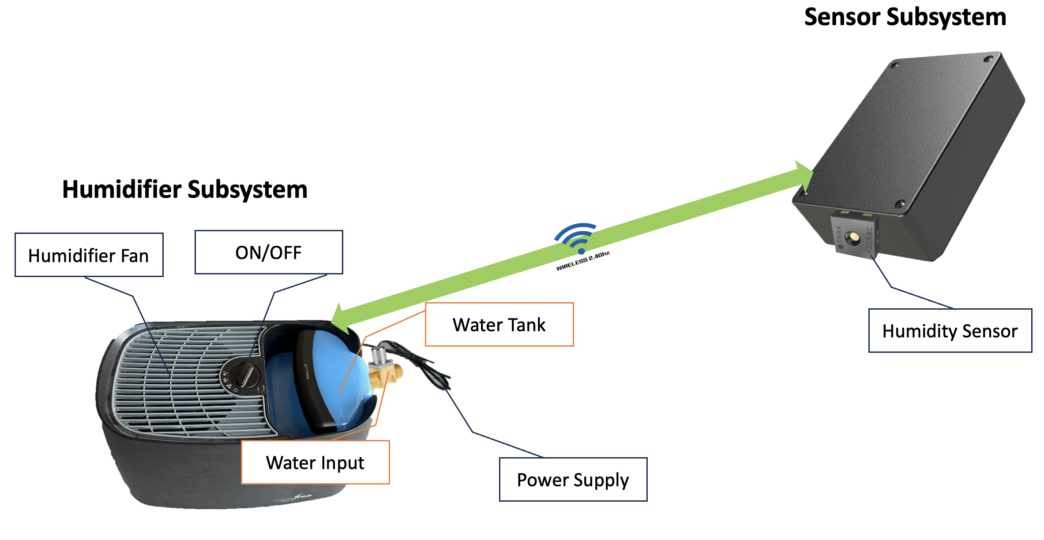
Visual Aid
Notes:
Woojin
Talking through 2.4 GHz

Slide 6
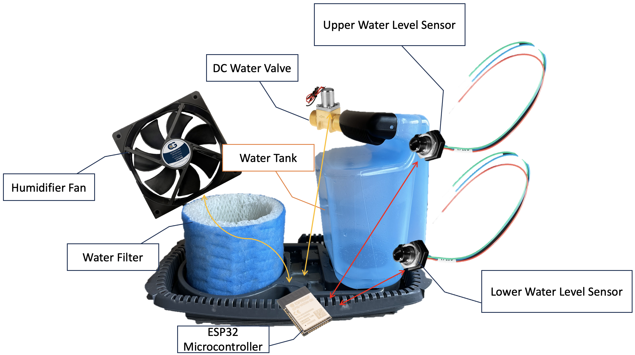
Visual Aid - Component
Notes:
Woojin
Two sensors locations
Water valve and Fan
-> all talks to ESP32

Slide 7

High Level 1
Humidifier's ESP32 communication with three different sensors via 2.4GHz Wi-Fi
Average humidity data from three sensors
Create temperature dependent humidity calculation algorithm
Notes:
Jalen

Slide 8

High Level 2
Open/close valve to refill the water tank
Two water level sensors GPIO input to ESP32
Max capacity of the water tank: 4.16 liters
Filter absorbs around 150 milliliters ± 5 milliliters
Evaporation rate approximately 173 milliliters per hour (in 40% humidity room)
Notes:
Jalen
173 milliliter is from (max capacity)/(time for tank to empty) = 4160/24-hour = 173.33 milliliter
Filter absorbing 150 milliliter is from wringing out filter and measuring the volume

Slide 9


High Level 3
On/off fan based on pre-configured ideal humidity range, 35% and 50% humidity, based on an algorithm averaging the readings from 3 sensors
Actuate relay with LED output for ON signal
Theoretical estimation of 44ns response time to on/off the humidifier’s fan (w/o runtime)
High voltage (120V AC) components does not interfere with low voltage components (< 12V DC)
Notes:
Woojin
44ns from: SHT45 -> ESP32 -> wifi of 6m range -> ESP32 -> algorithm -> relay actuation

Slide 10
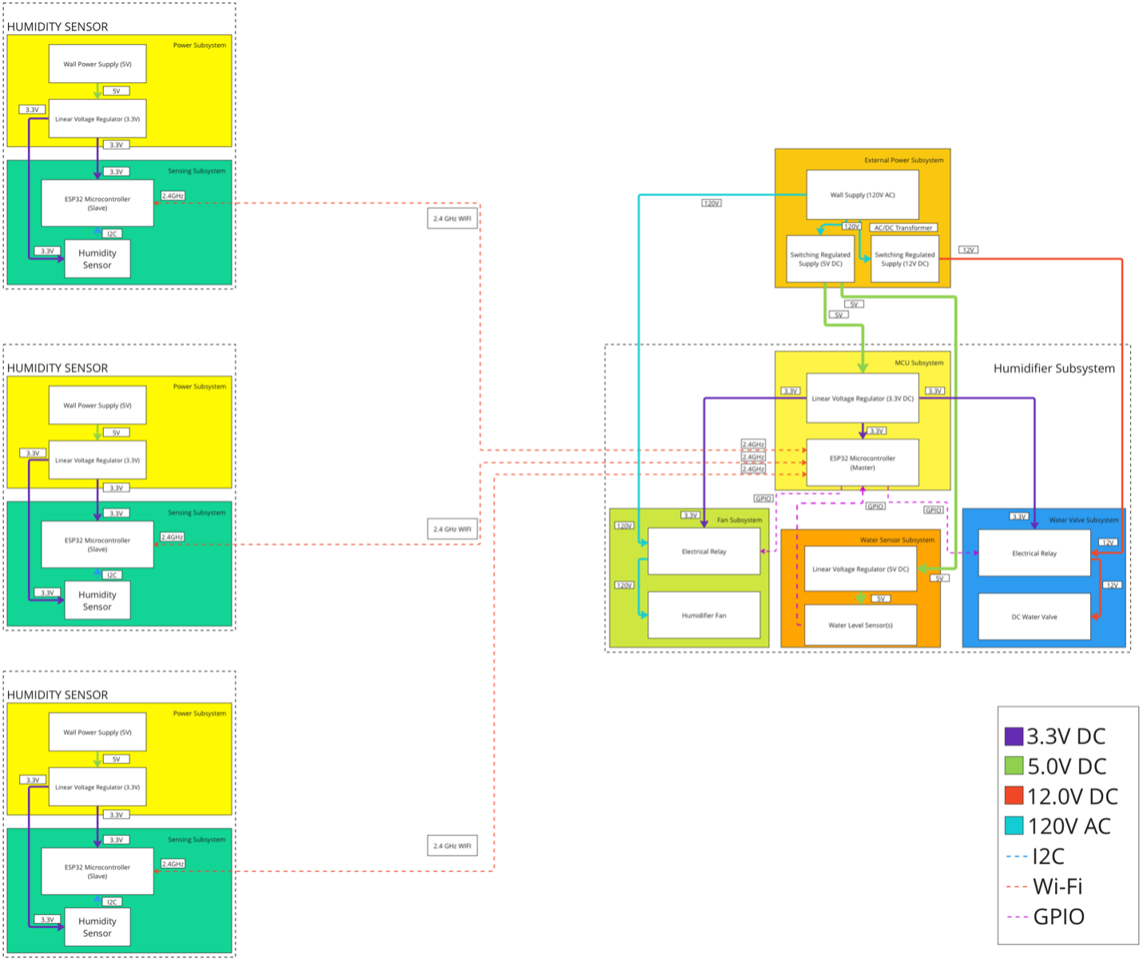
Block Diagram
Notes:
andrew

Slide 11
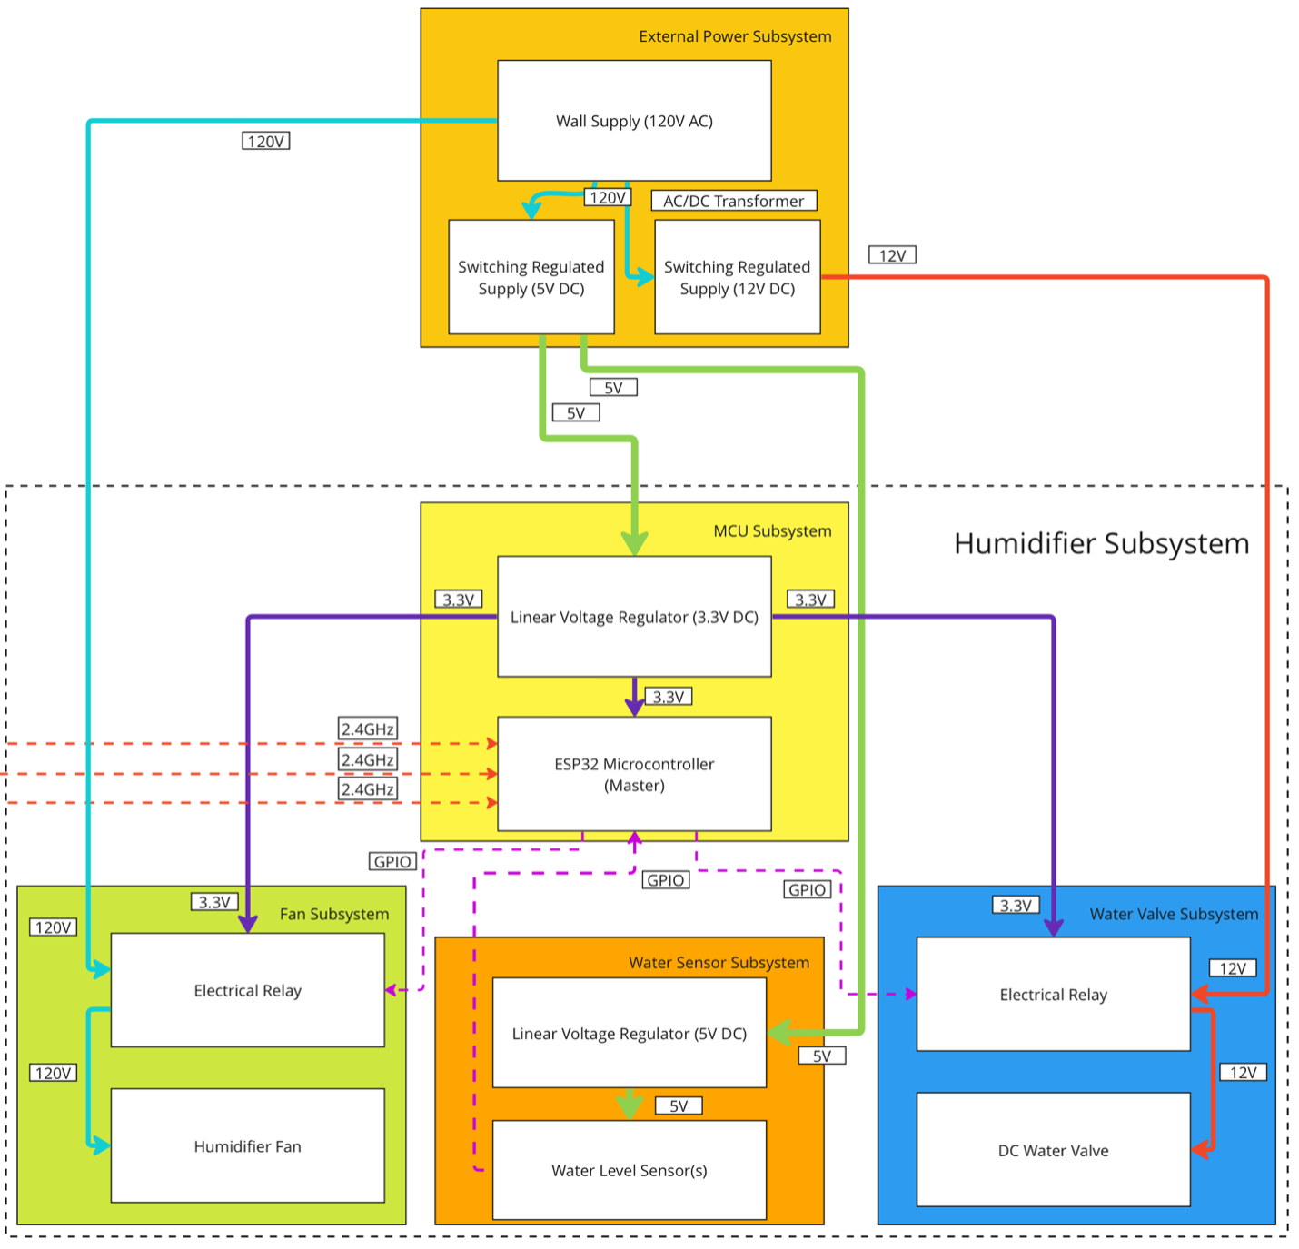
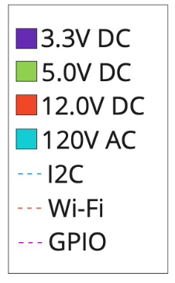
Block Diagram - Humidifier
Notes:
andrew

Slide 12
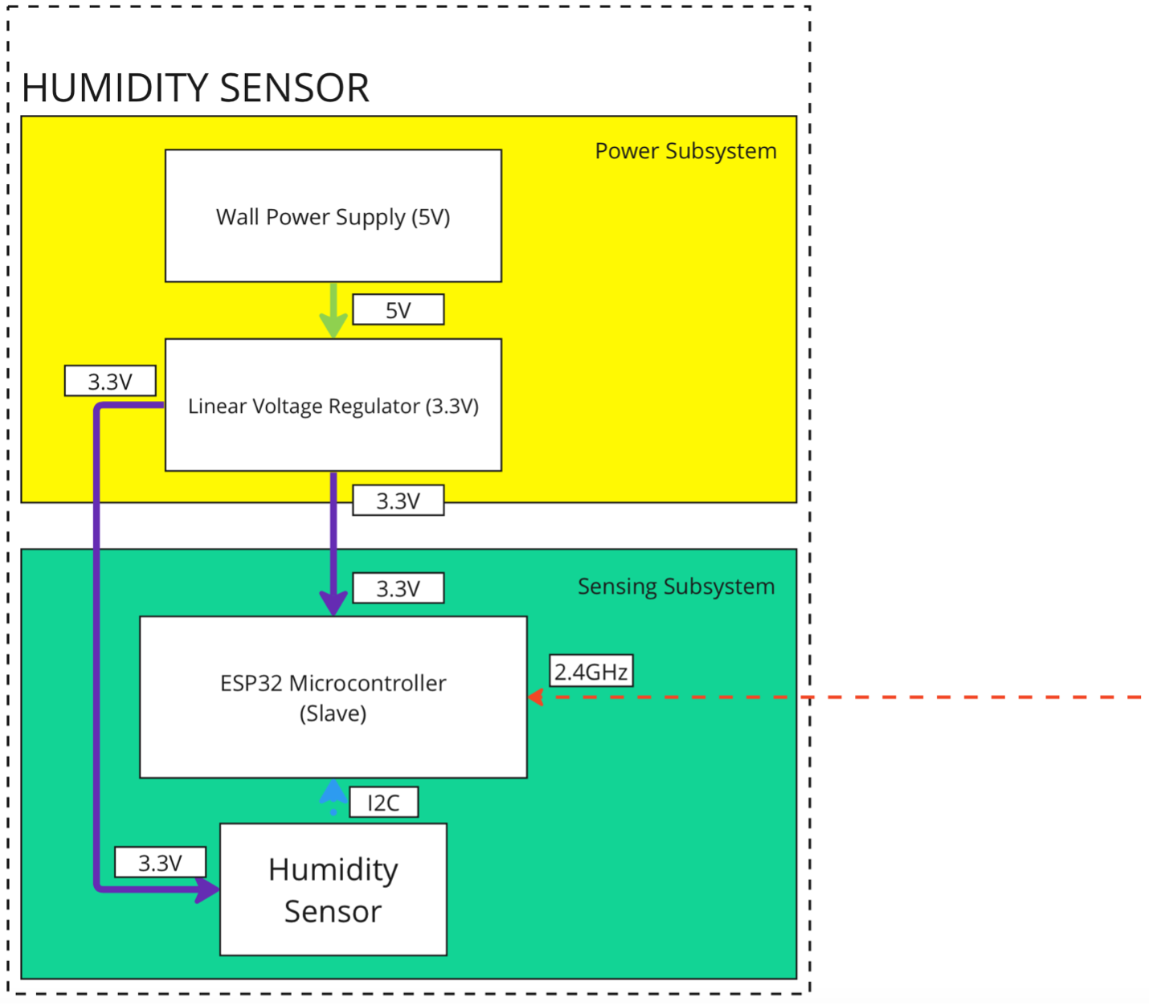
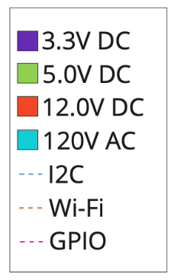
Block Diagram - Sensor
Notes:
Andrew

Slide 13
Demonstration

Slide 14
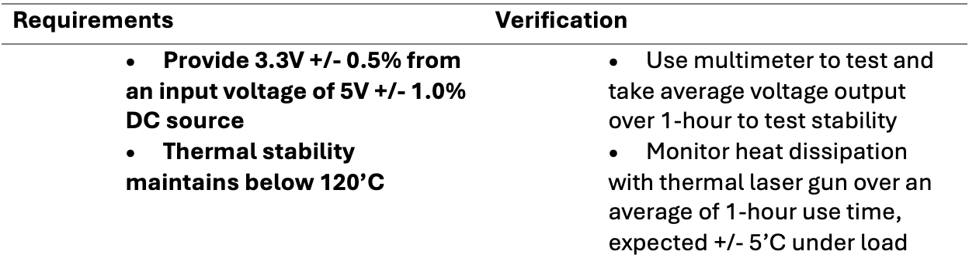
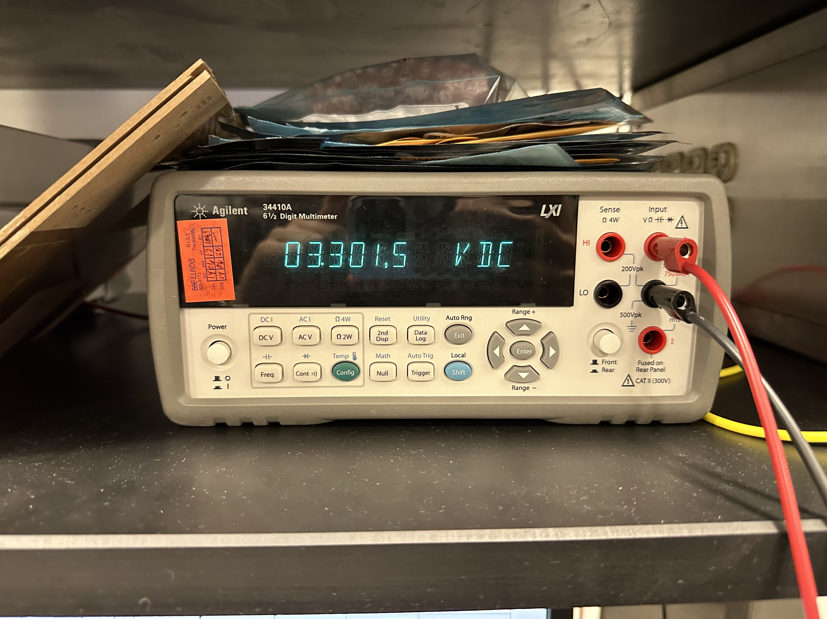
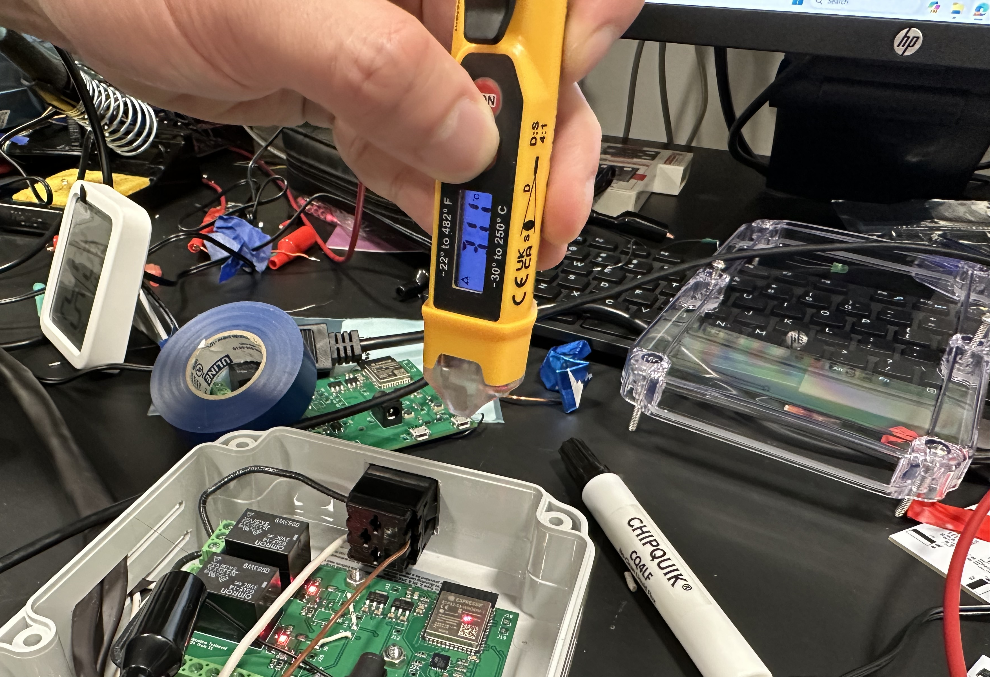
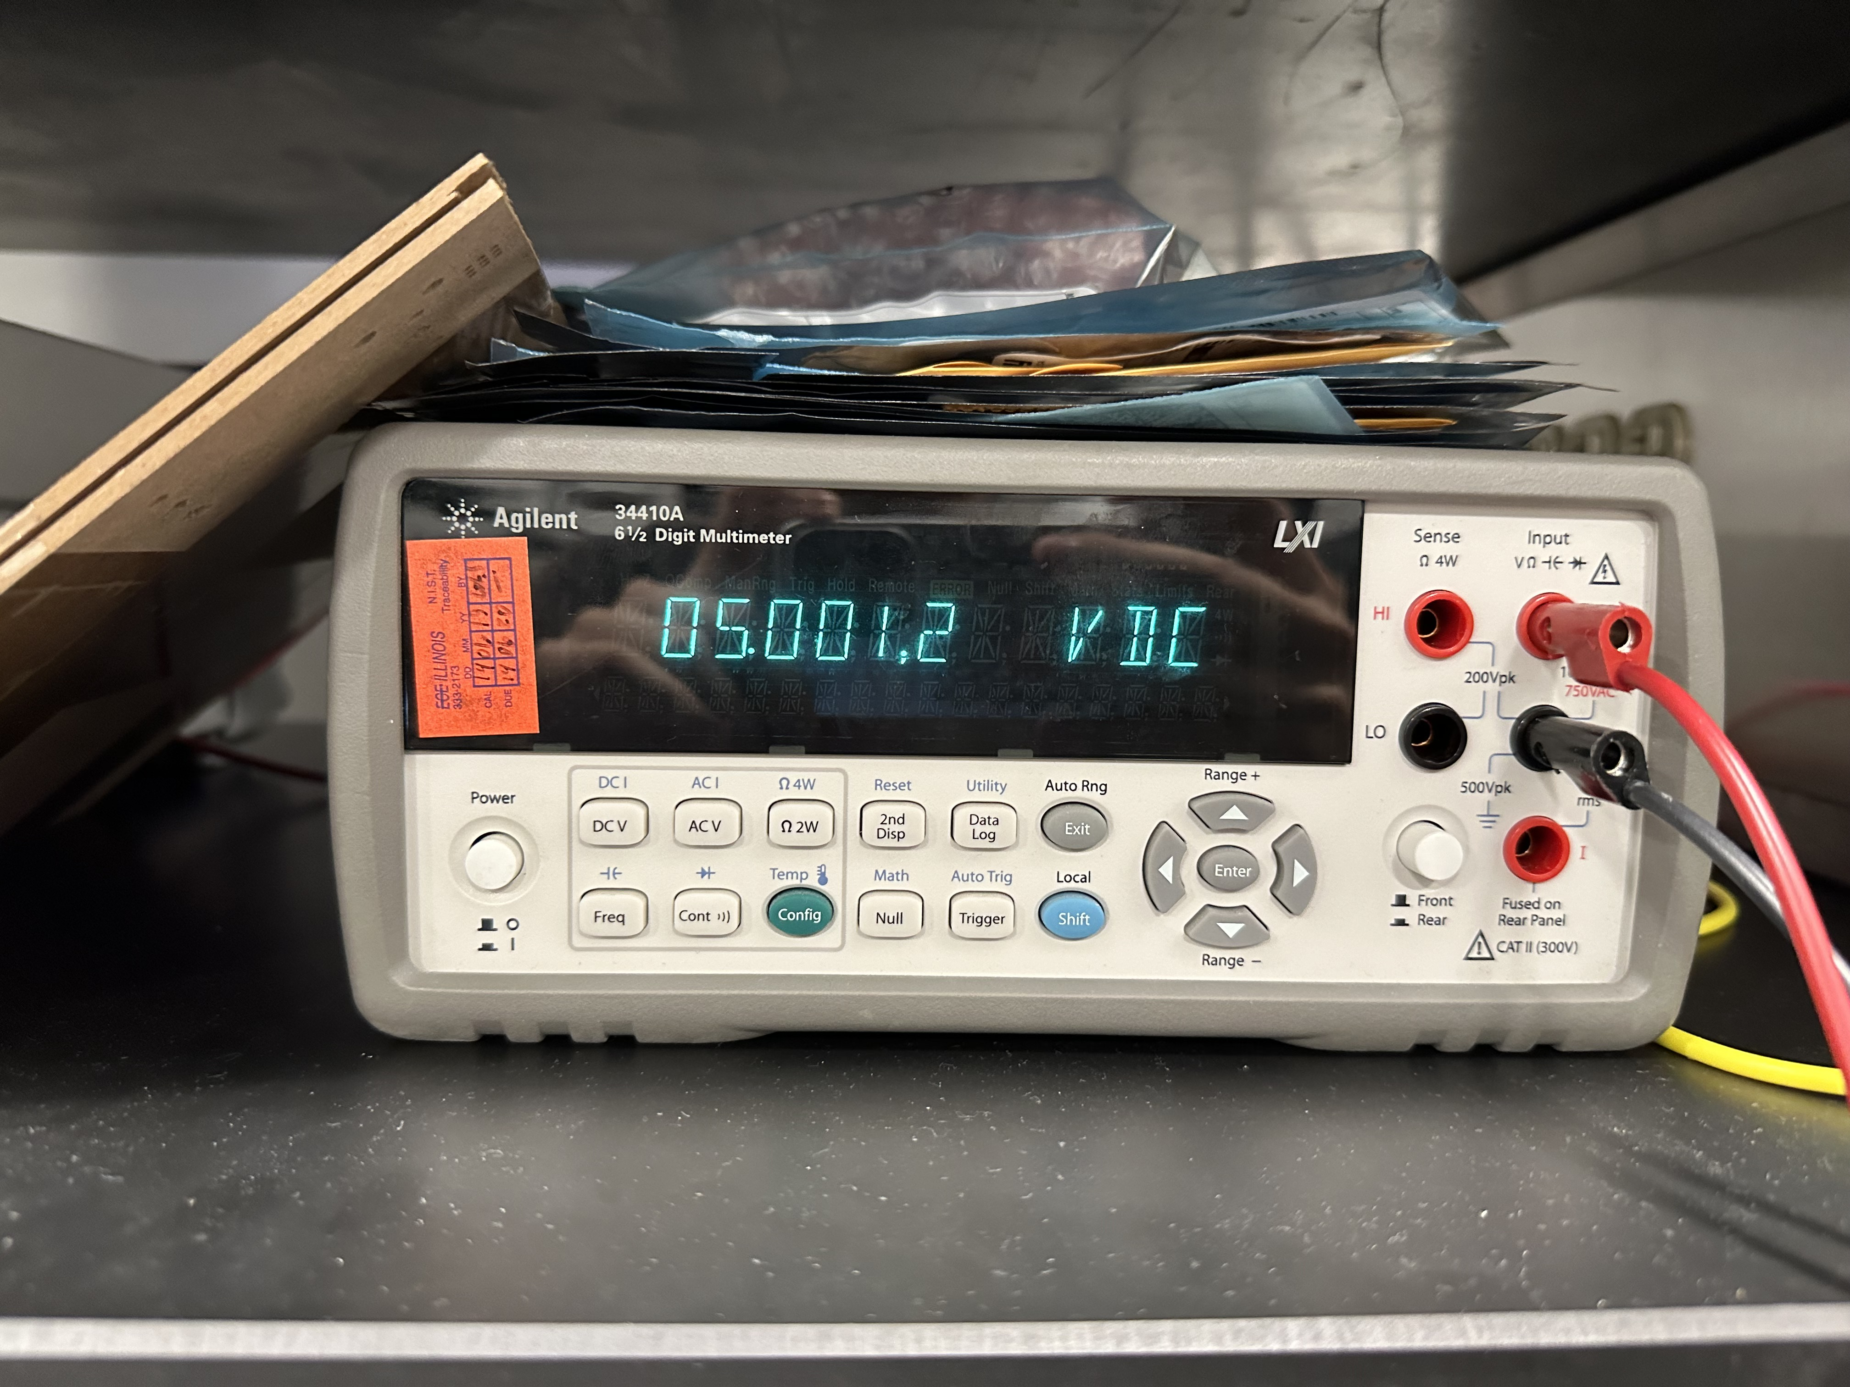
RV Table – Central Humidifier Subsystem (1)
3.3V linear regulator output
Temperature reading with laser
5V linear regulator output
Notes:
jalen

Slide 15
RV Table – Central Humidifier Subsystem (1)
Notes:
jalen

Slide 16
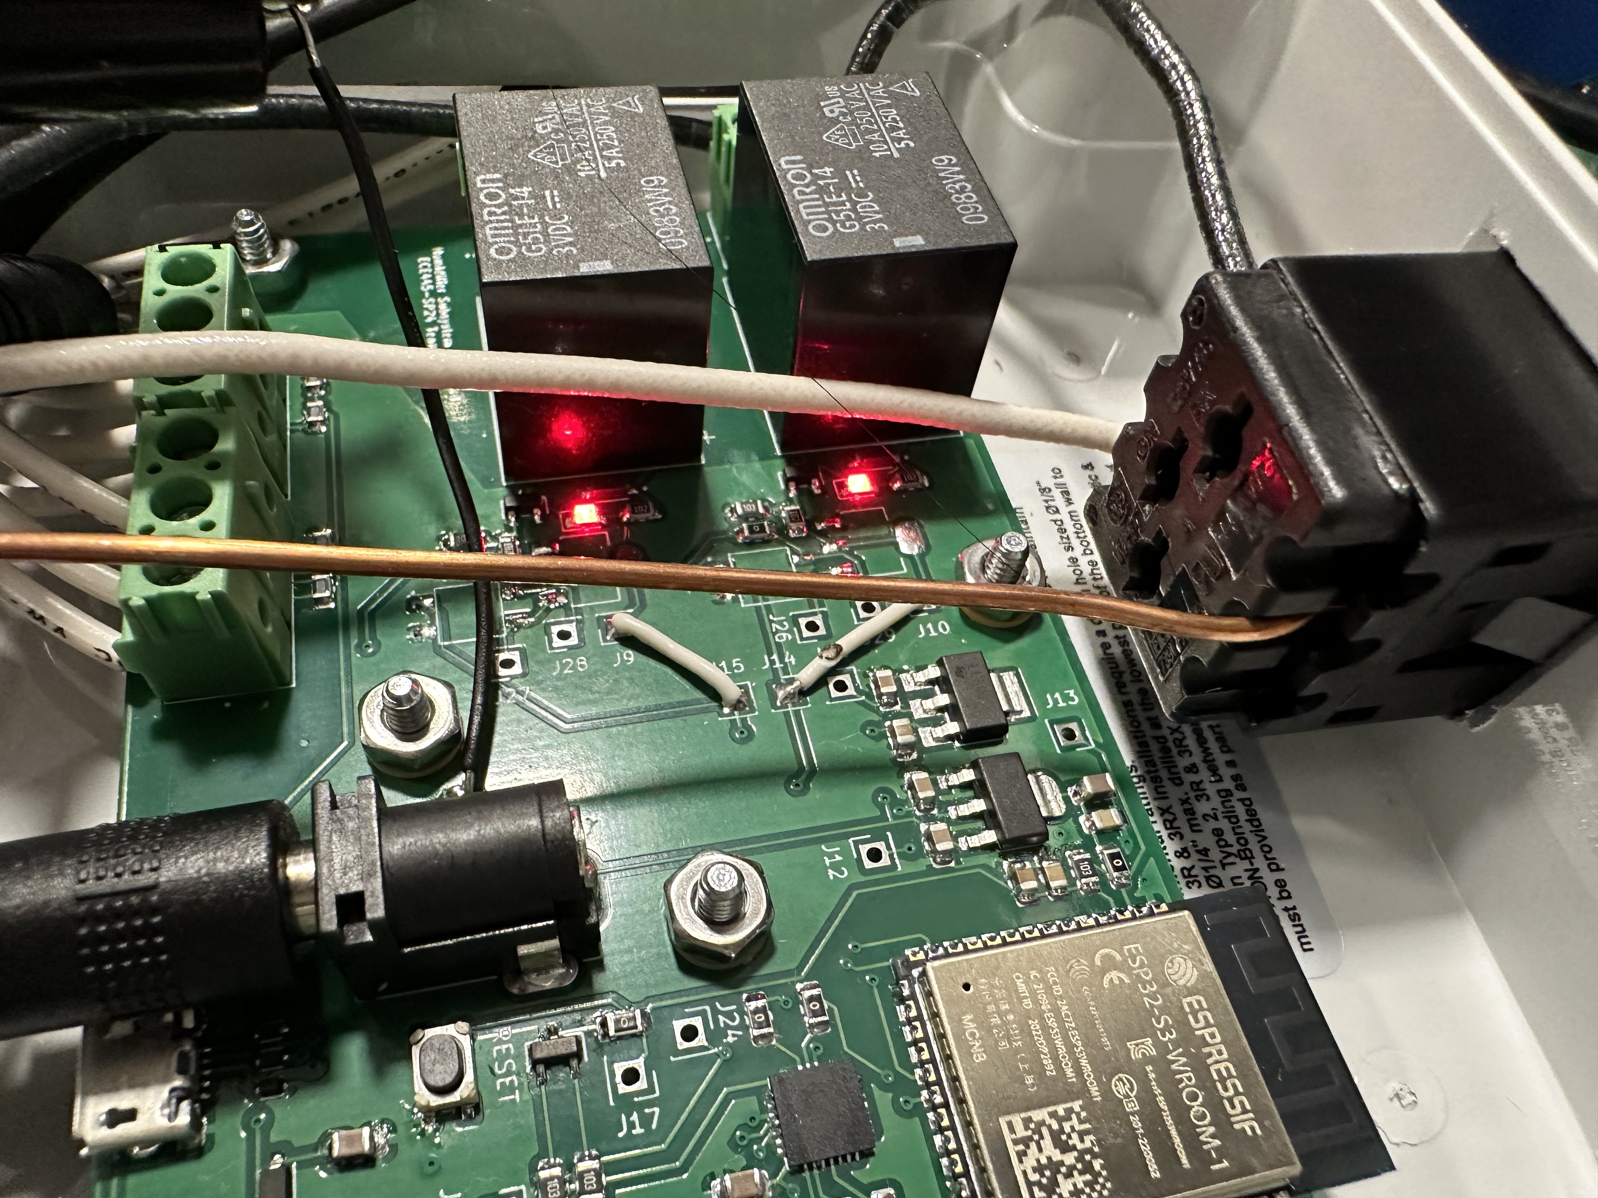
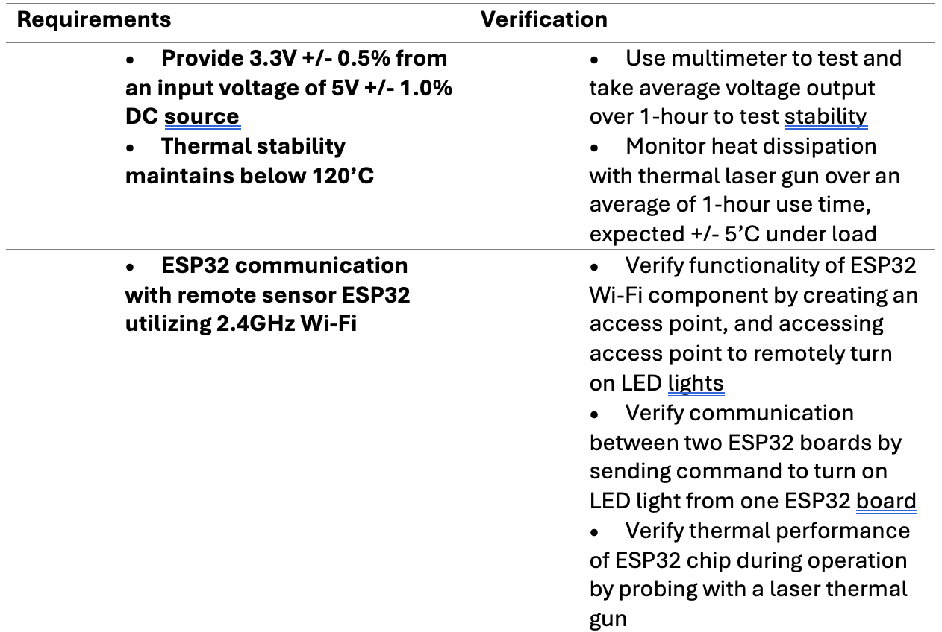
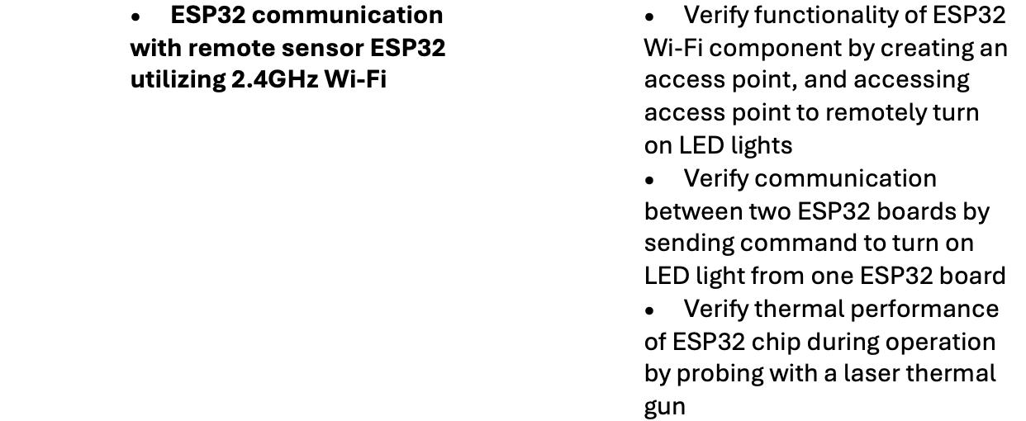
RV Table – Central Humidifier Subsystem (2)
LED light control example
Temperature reading example
Notes:
jalen

Slide 17
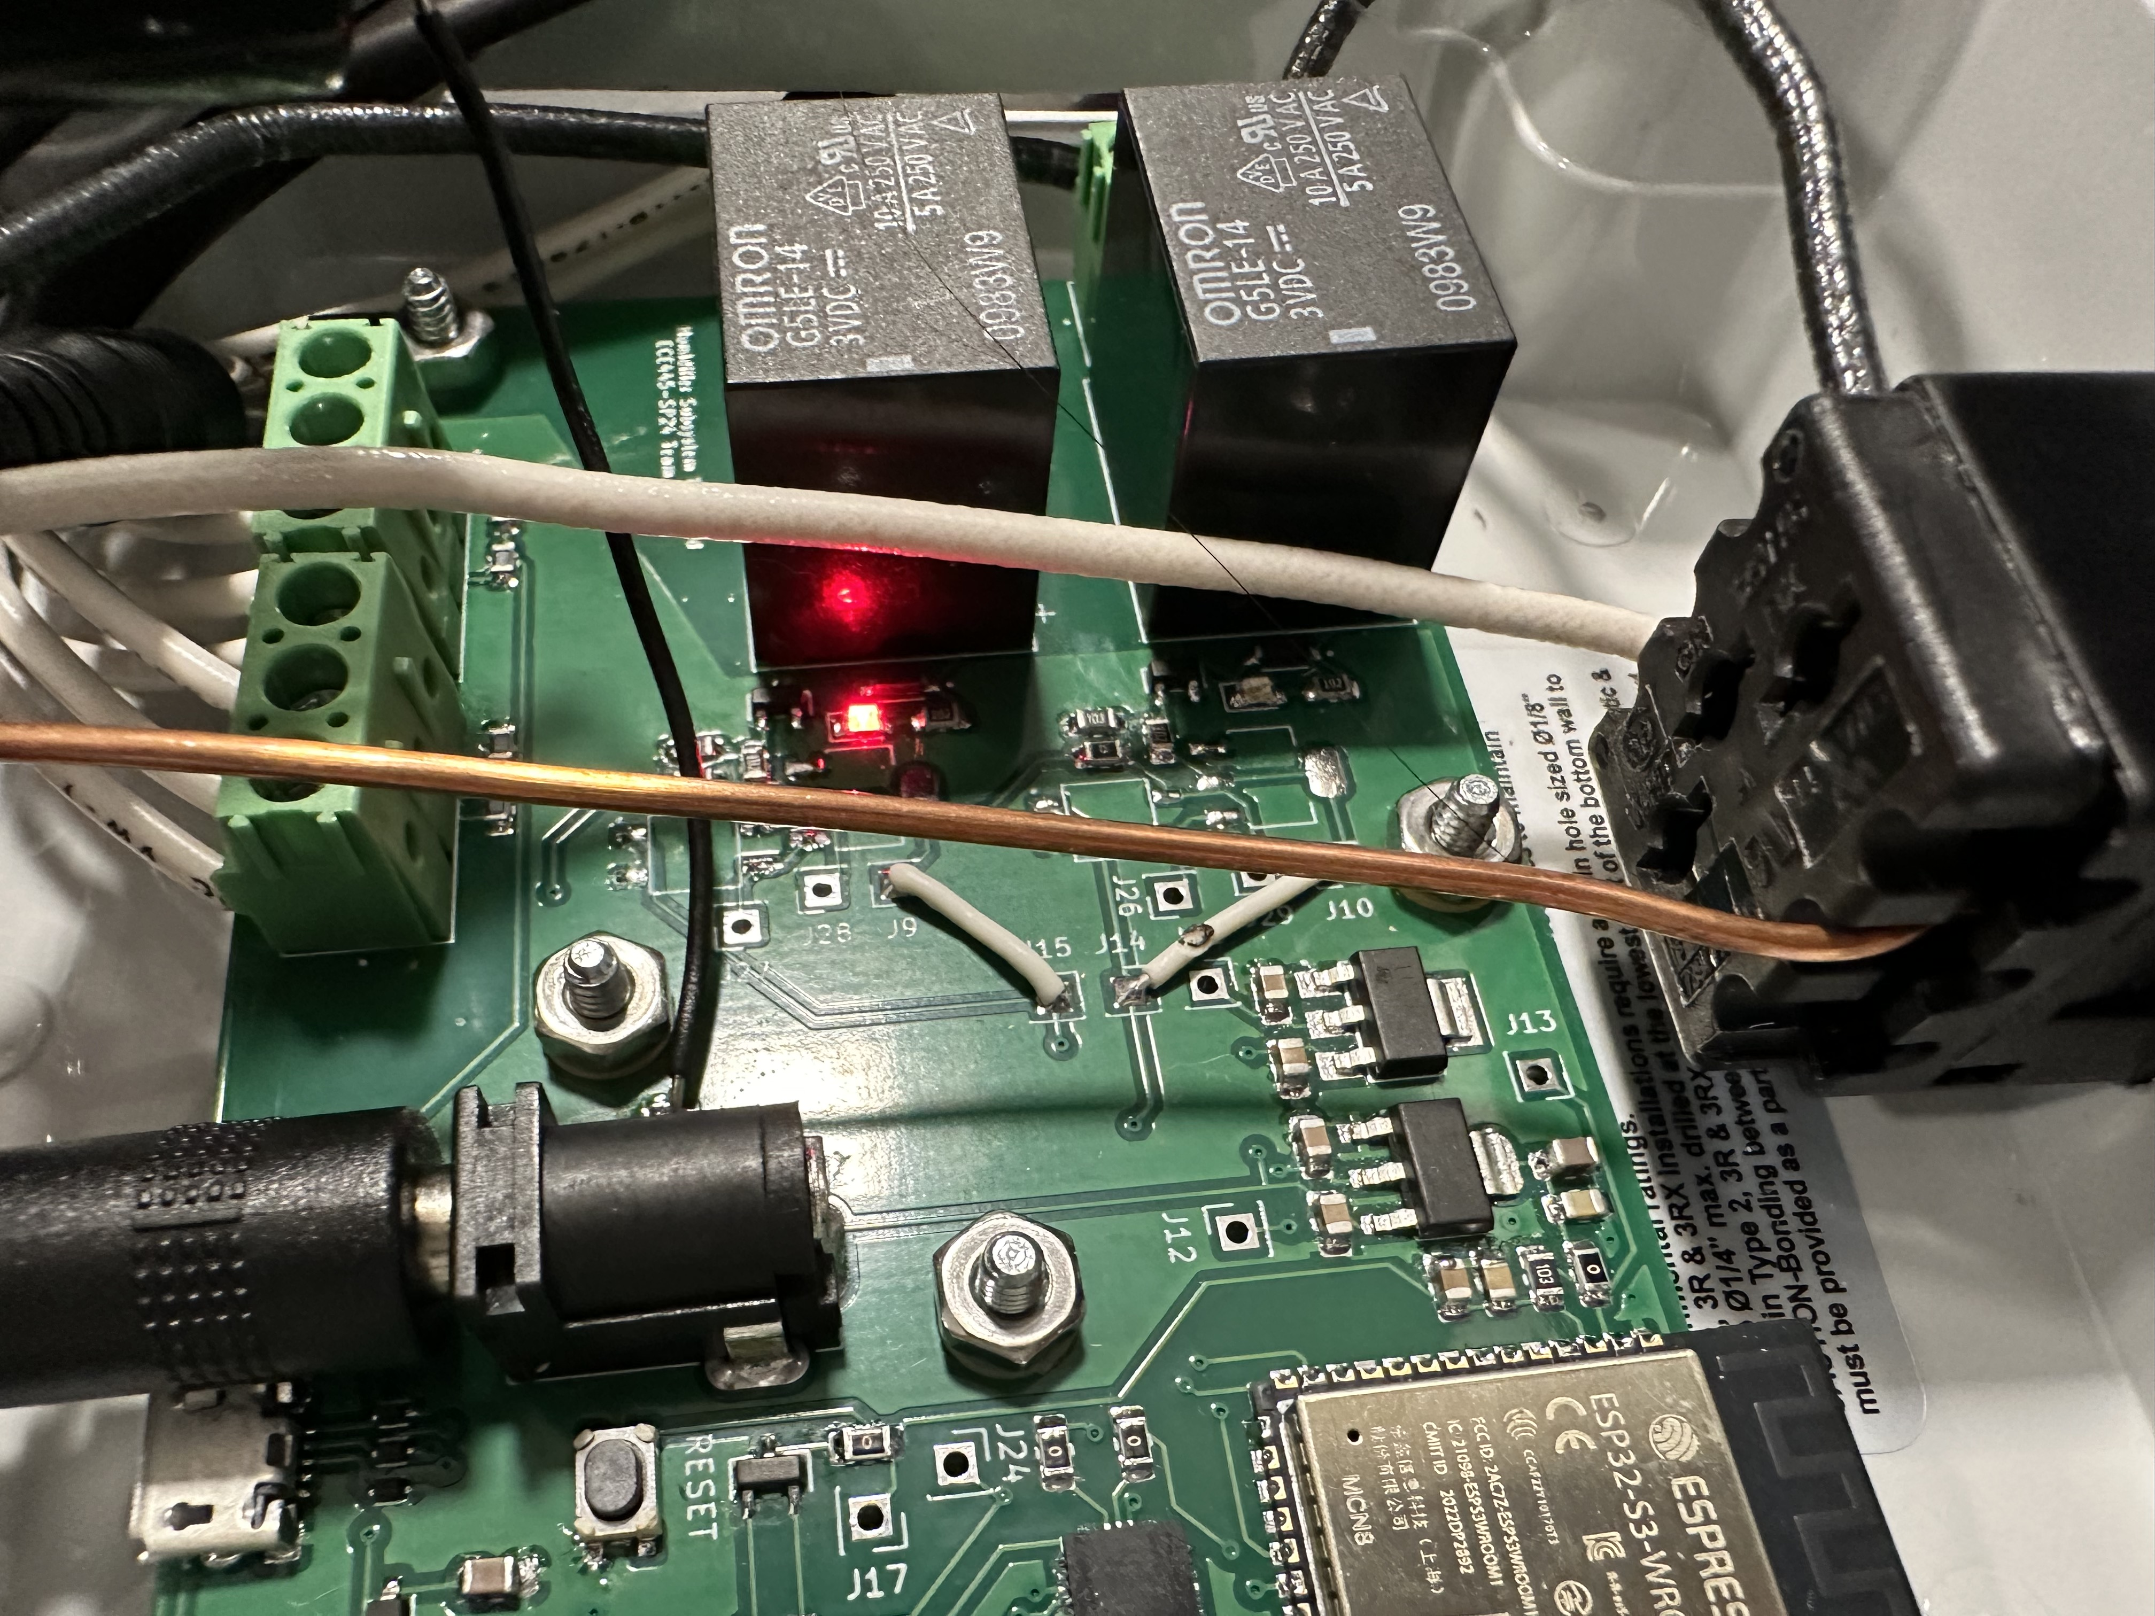
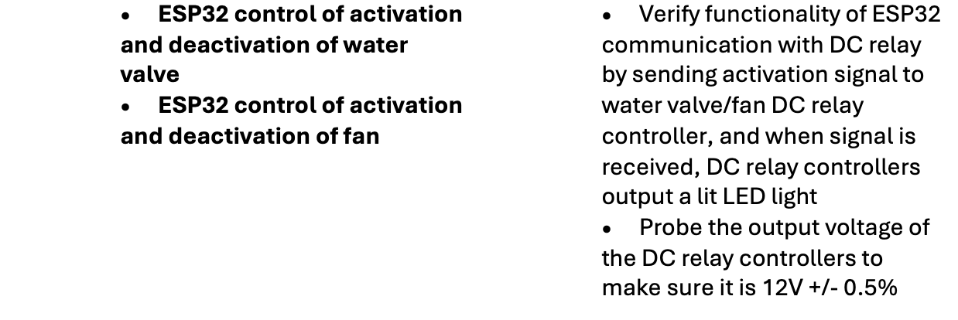
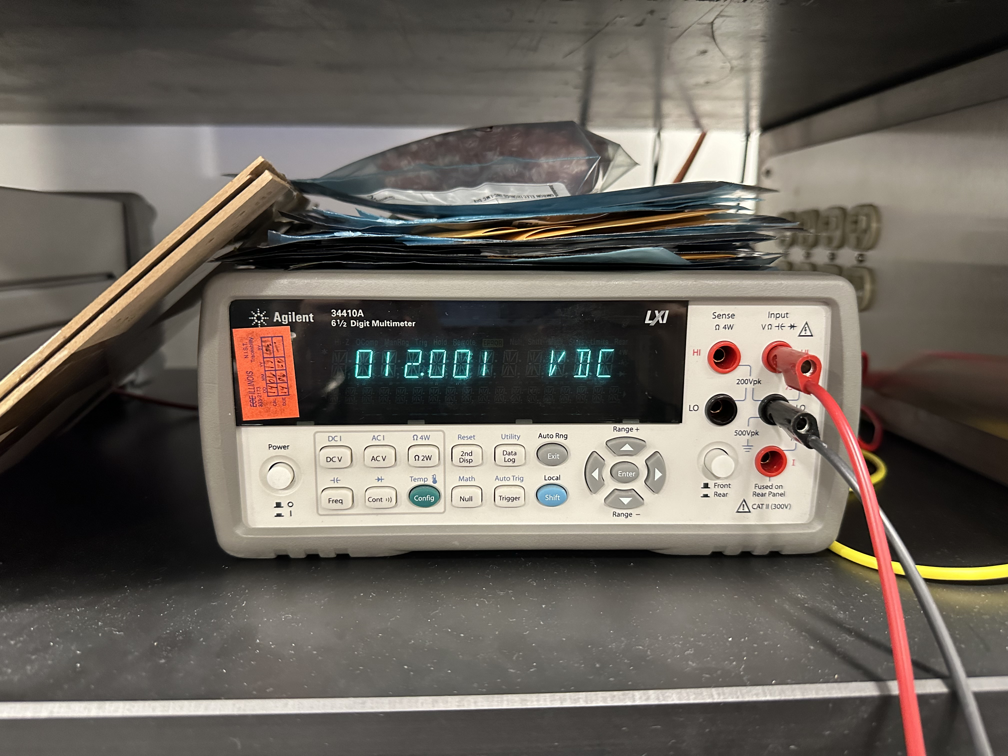
RV Table – Central Humidifier Subsystem (3)
LED light when valve is on
12V output to water valve
Notes:
jalen

Slide 18
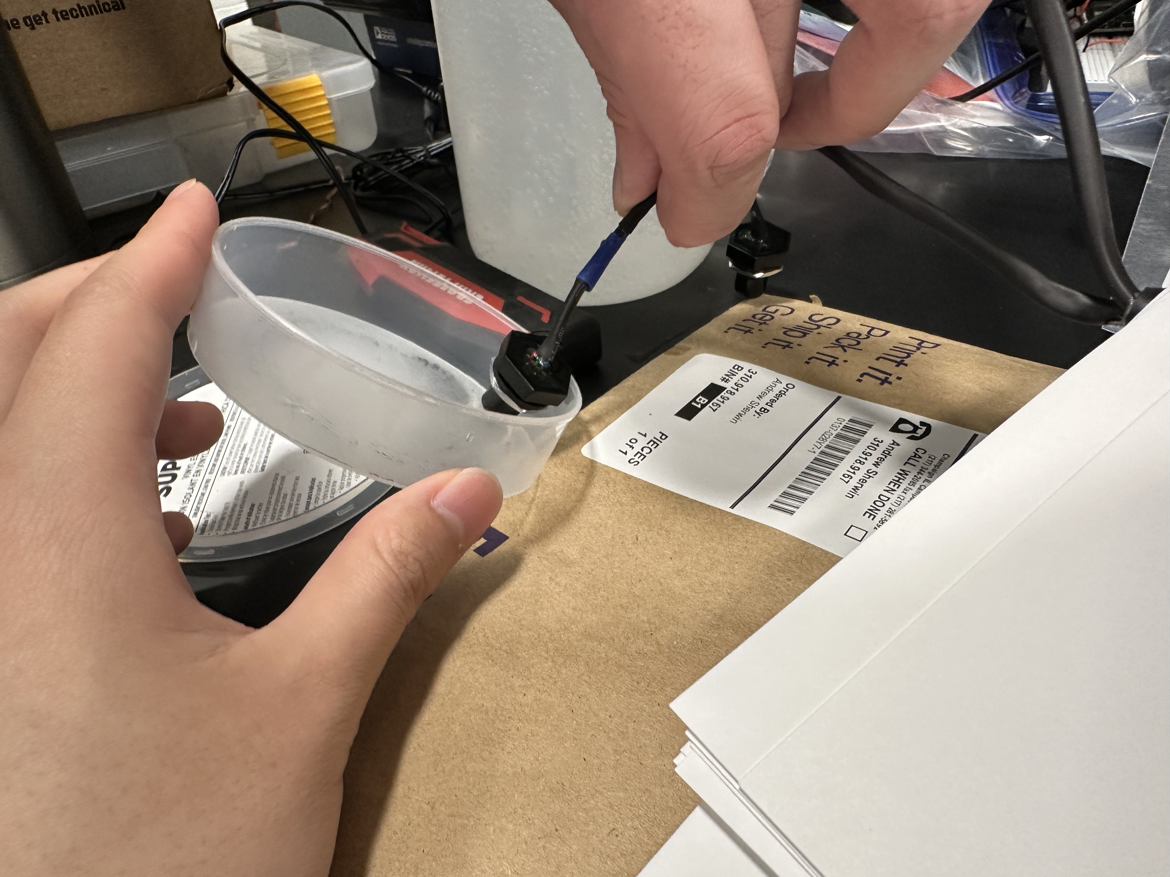
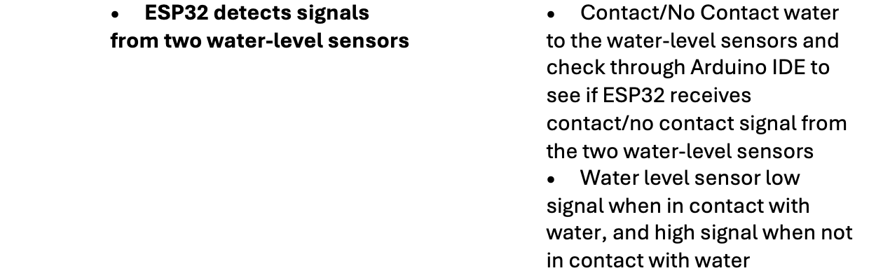
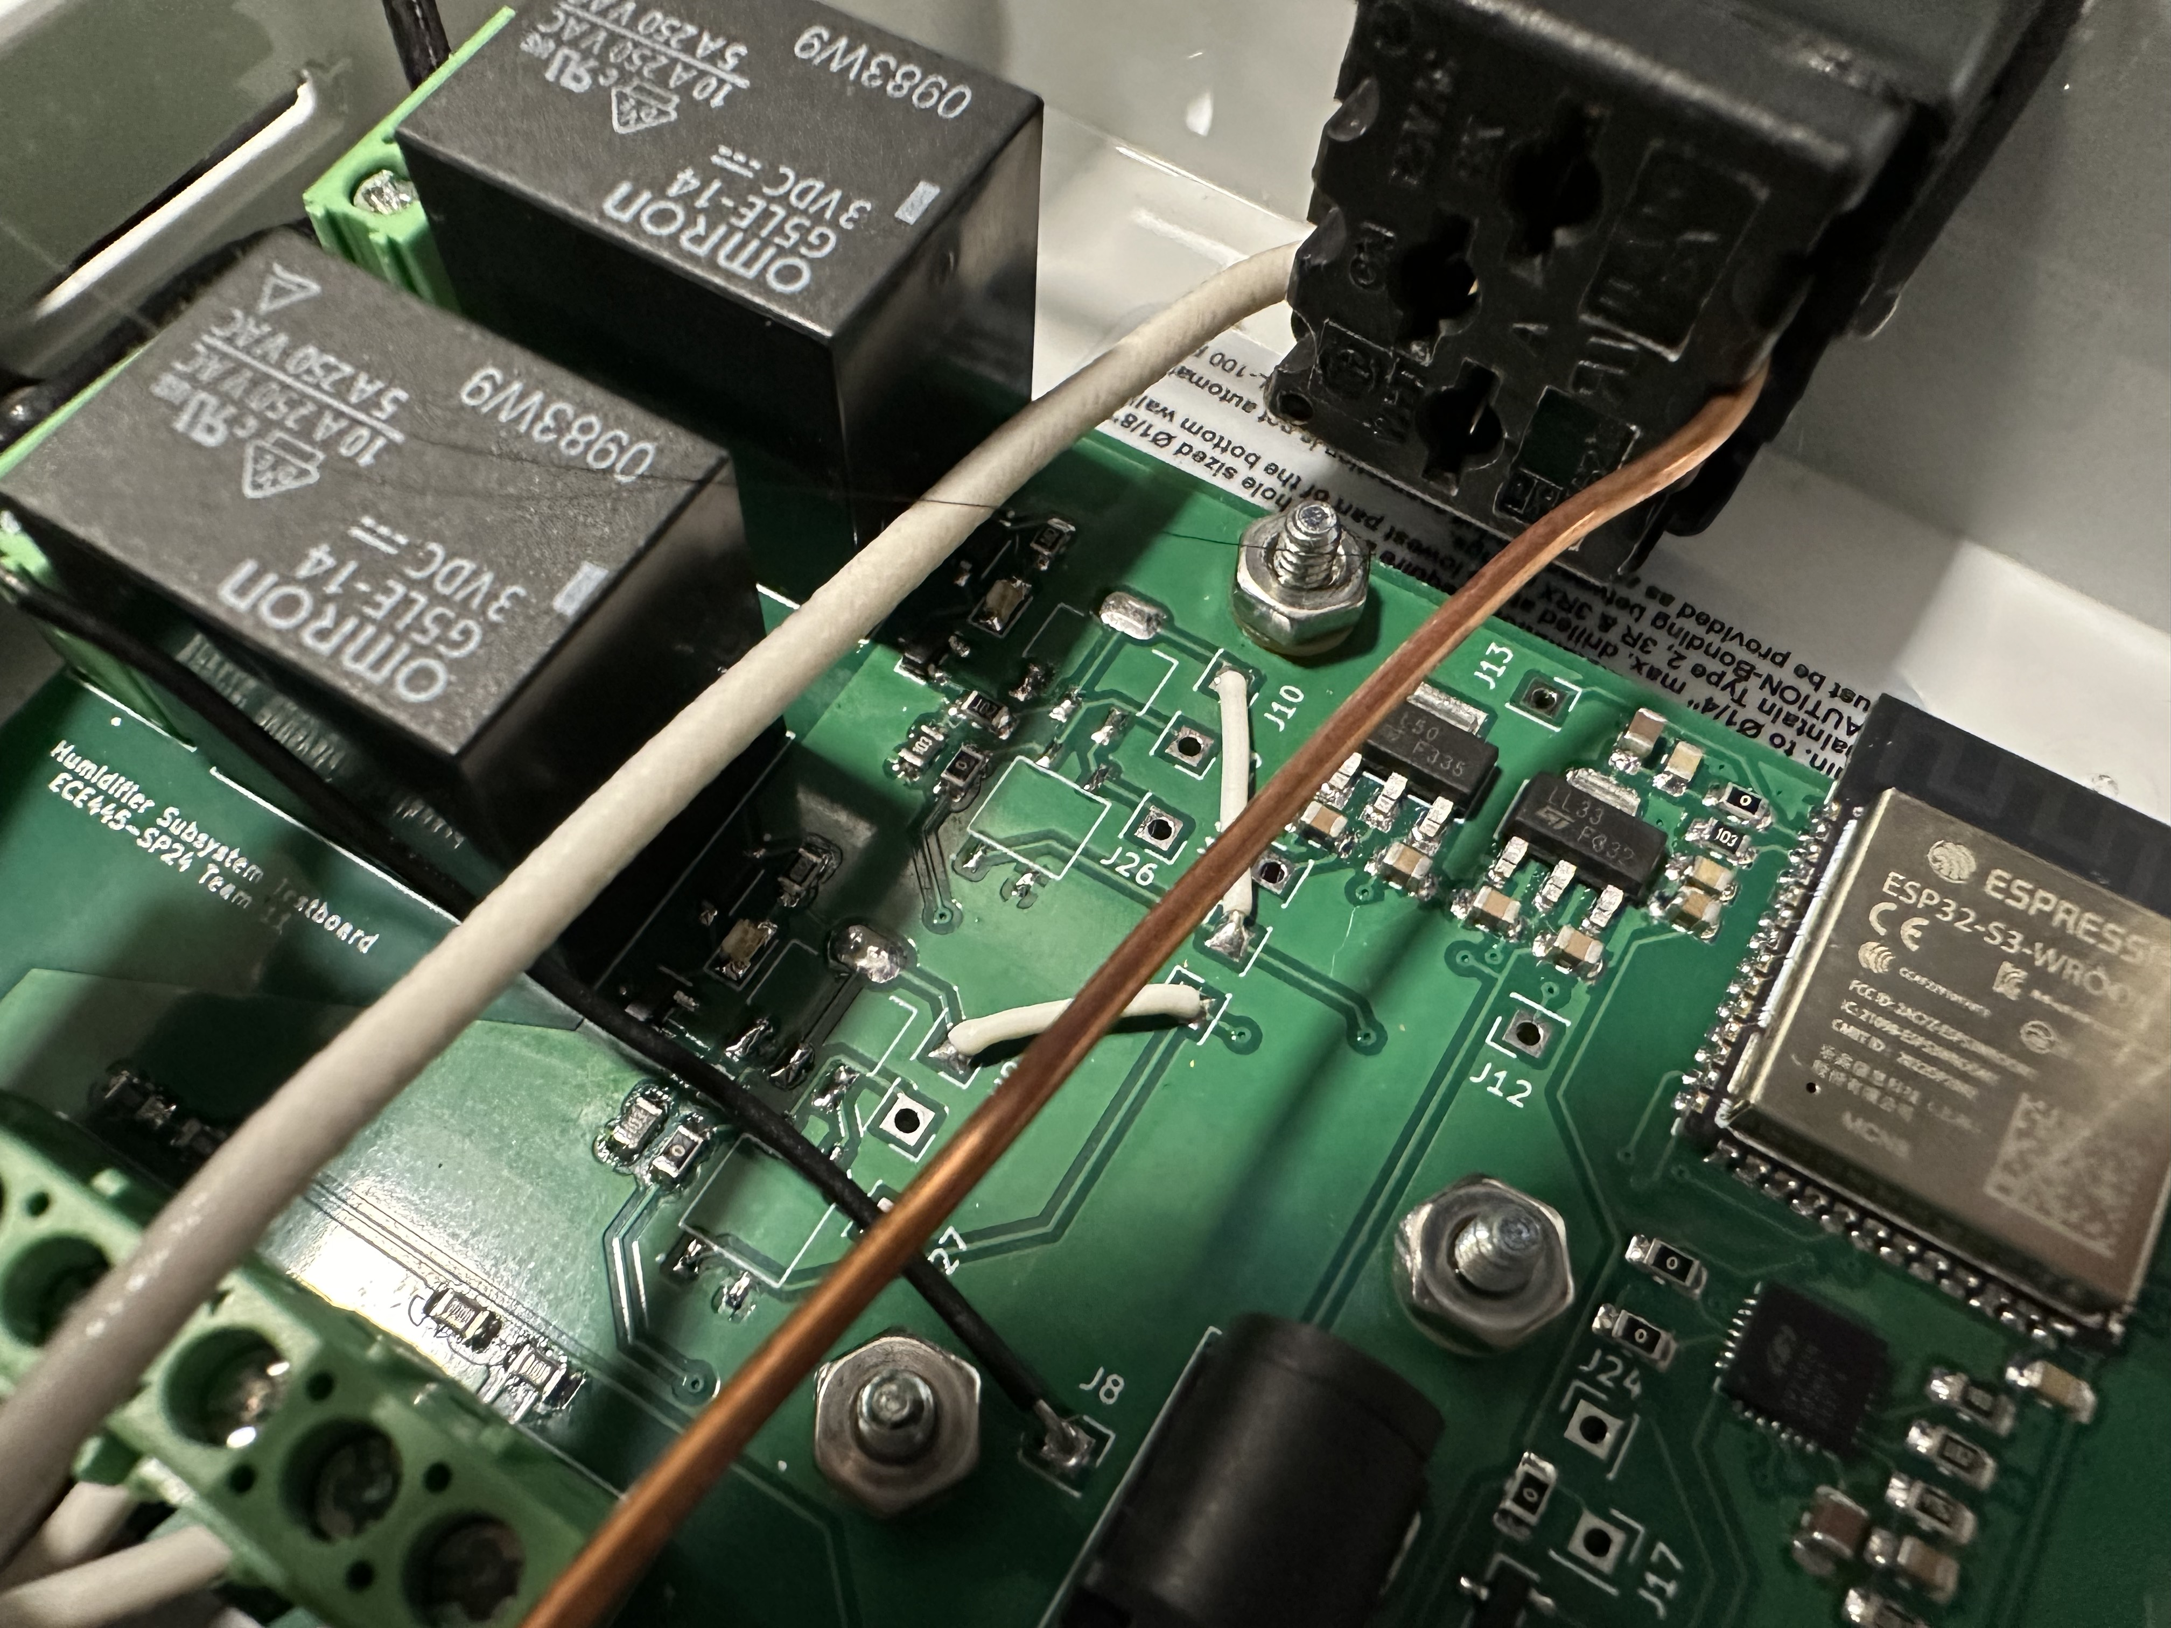
RV Table – Central Humidifier Subsystem (4)
Water level sensor contact water
Water-valve off when water detected
Notes:
jalen

Slide 19
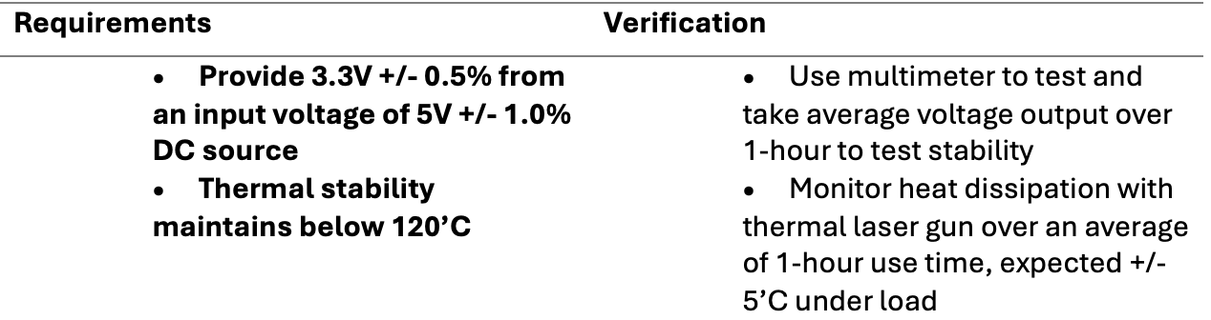
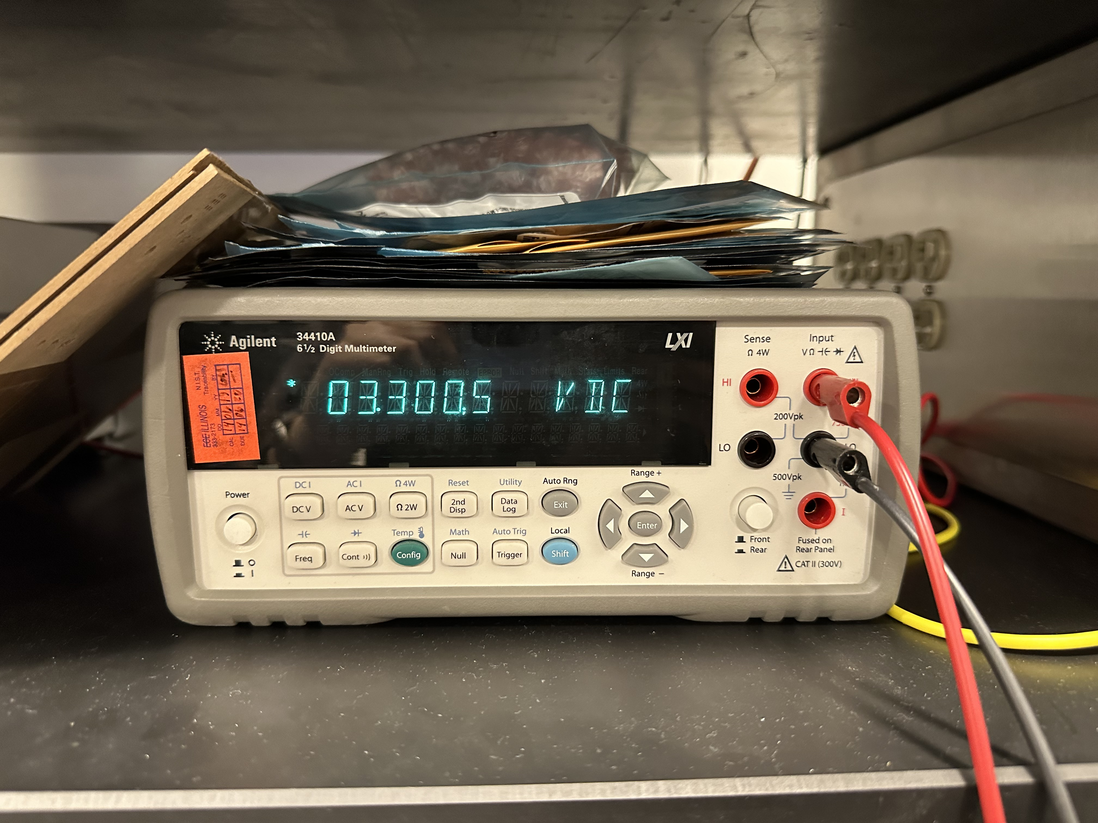
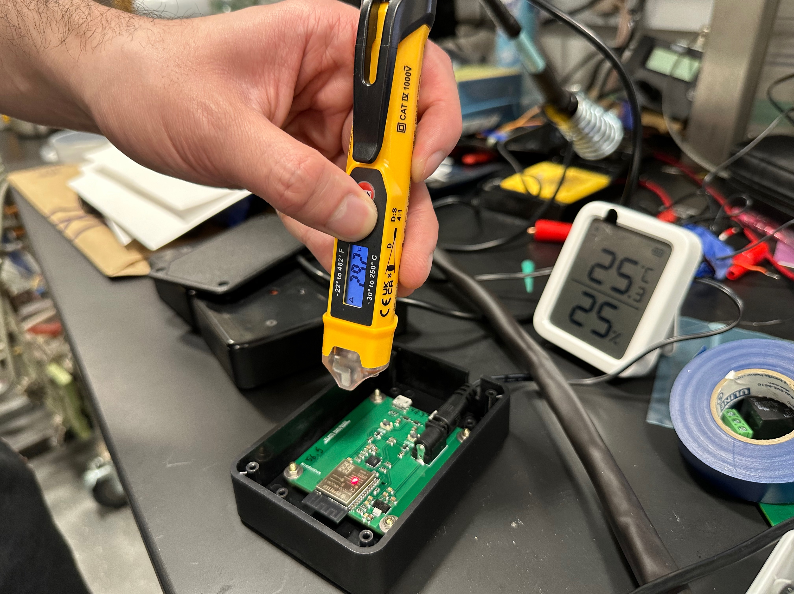
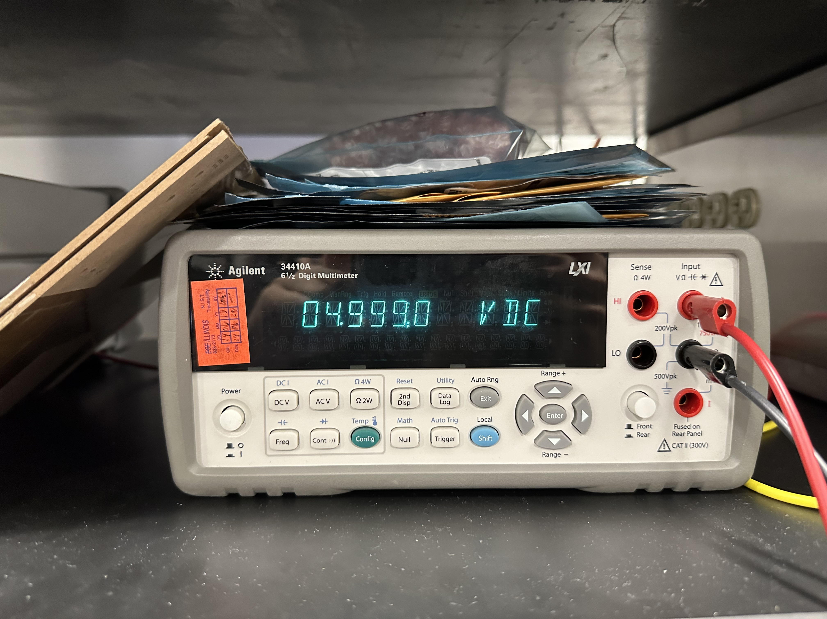
RV Table – Humidity Sensor Subsystem (1)
3.3V linear regulator output
Temperature reading with laser
5V linear regulator output
Notes:
woojin

Slide 20
RV Table – Humidity Sensor Subsystem (1)
Notes:
woojin

Slide 21
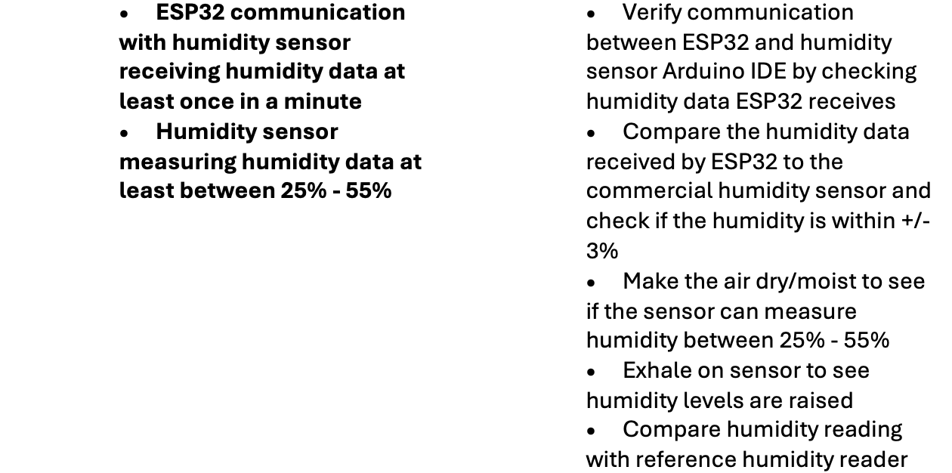
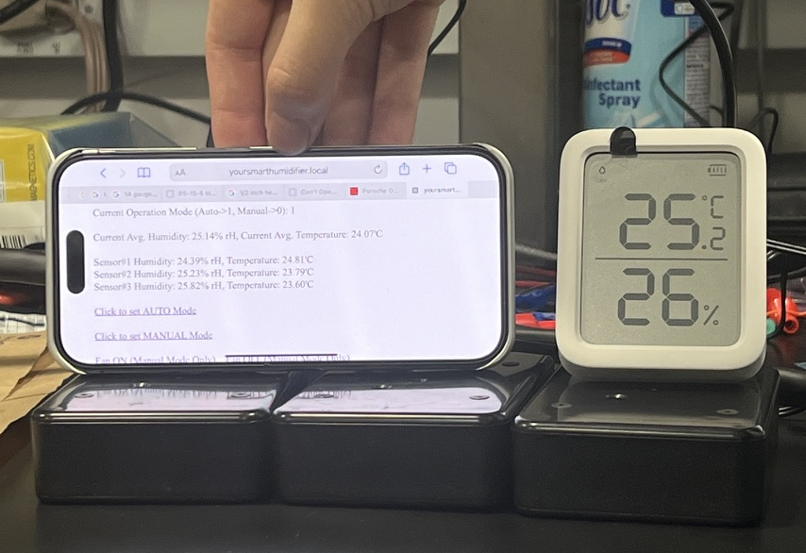
RV Table – Humidity Sensor Subsystem (2)
Commercial humidity and temperature sensor verification
Notes:
woojin

Slide 22
Project Achievements
Sensor Subsystem reads temperature and humidity data from SHT45
Sensor Subsystem communicates with Humidifier Subsystem with Wi-Fi
Humidifier Subsystem successfully activates humidifier
Humidifier Subsystem successfully activates water valve
Humidifier Subsystem successfully reads from water level sensors
Bonus:
User Interface through access point to control Humidifier Subsystem
Notes:
Andrew

Slide 23
Future Plans
Integrate with Amazon Alexa, Apple HomeKit, and Google Assistant
Further compact PCB
Remove ESP32 programming components
Improve PCB enclosure design
Improve UI design
Potentially remove water level sensor and water valve
Consult with business consultants to push product on market
Notes:
Andrew

Slide 24
Your Oasis Awaits: Refresh, Rejuvenate, Breathe
Notes:
Everyone//end

Slide 25
